Slide 1


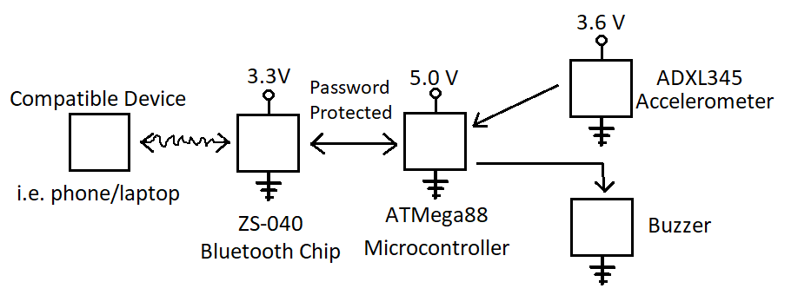
AlertLife: Incident Monitor in Assisted Living Facilities
P 14
Team Members: Zain Khan, Karson Sommer
Abstract
This project will create a body mountable monitoring device that will send a signal via Bluetooth and trigger an alarm if it detects the person wearing the device has fallen. The device will be small enough so that it can be worn as an armband. The Bluetooth broadcast will broadcast a random name with a PIN controlled access for security. It will detect whether a person has fallen using accelerometer data sampled every
Introduction
The product we designed and built, was inspired by the LifeAlert® system. This provides seniors who live alone with an emergency system in case they fall. We designed our product specifically for assisted living facilities since the requirements for the product would be different than a general case.
In a low-staffed assisted living facility, a resident may get up to go to the bathroom at night, trip, and break there hip and knock their head and become unconscious. They may not be checked on until the morning. We envision a better version of our product can be worn as a necklace or bracelet. If it detects a resident has fallen, it will send a Bluetooth signal and trigger an alarm. The facility will have access nodes to read Bluetooth throughout the building which will communicate with a server that then sends the data to a mobile app for caretakers to alert them if a resident needs to be checked on. This may be integrated with previously existing systems.
LifeAlert® Slogan
System Description
Shown are the individual components in the system. On powerup, the system needs to be paired with a compatible device using a PIN. The accelerometer continuously feeds data to the microcontroller, which makes the decision when a fall may have occurred. When a fall has occurred, the buzzer is powered on by the microcontroller and a signal is broadcast through the Bluetooth board. The buzzer remains on until the end-user shuts it off. This is done by sending the correct password over Bluetooth to signal the patient has been checked on.
Communication Overview
Results
In this section, present some results for your project. This could be a plot of data you have collected. For most term projects in this class, however, this will be a photograph or two showing the complete system.
For example, if you designed a “gizmo” that attaches to a bicycle, you would show an “action shot” of a person on the bicycle. The figure(s) should have a short caption(s).
The purpose of this section is to explain how it all came together. A terrible rookie mistake is to focus on what went wrong. Focus on the success stories in your project!
Caption: Photograph of gizmo attached
to bicycle
Lessons Learned
Conclusion
The original accelerometer we purchased had no libraries to make it easily compatible with C. We purchased a different accelerometer which had C language support and was often used with AT microcontrollers.
The Bluetooth transmissions were able to be picked up by one partners phone and laptop, but the other partner couldn’t pick it up on either his phone or laptop. This was caused by incompatible Bluetooth drivers.
We attempted to use dynamic time warping to determine if a fall was detected. Our microcontroller did not have enough memory for its library, which made its implementation impossible.
We feel that our product successfully completed the goals we set out for. With more efficient design and smaller components, the product could be made small enough to fit on a necklace or wristband for convenience. The operation of the product seems to be effective for what it was designed for, presumably the cost of production would be relatively low. This makes the product a viable option for patient monitoring in a assisted living facility.
Acknowledgement
I2cmaster – Peter Fleury – Interfacing with I2C connection
adxl345 – Davide Gironi – Accessibility using the ADXL345 accelerometer
ECE:3360 Embedded Systems 2019
The University of Iowa

